Slide 1

PROJECT DESIGNING

Slide 2


Flow
ISSUES
S&S
PLAN
DEF
WHY
Powered by

Slide 3

WHAT IS PROJECT ?

Slide 4
A project is a way of organizing resource. It is a group of individuals who are assembled to perform different tasks on a common set of objectives for a defined period of time.

Slide 5
WHY PROJECT ?

Slide 6
Change agent
Acting sustainabily
global mindset
Social responsibility
Entrepreneurial outlook
Peaceful environment

Slide 7


WHAT ISSUES ?
ECONOMIC GROWTH
HEALTH IMPROVEMENT
LITERACY
LEADERSHIP AND CARREER DEVELOMENT

Slide 8
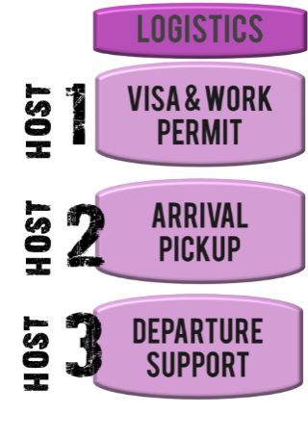
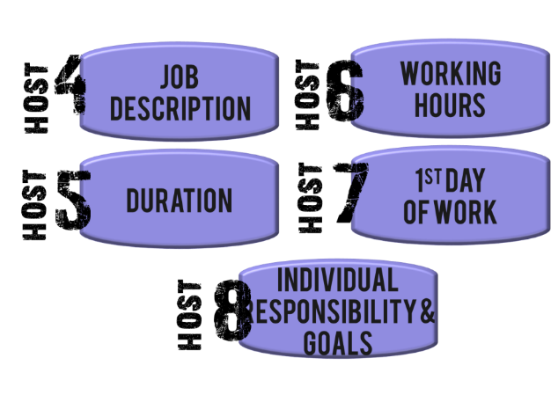




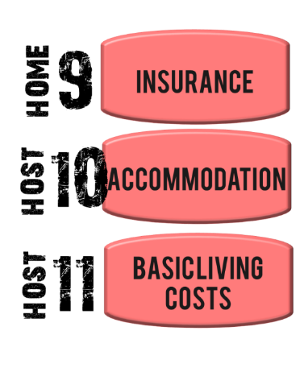
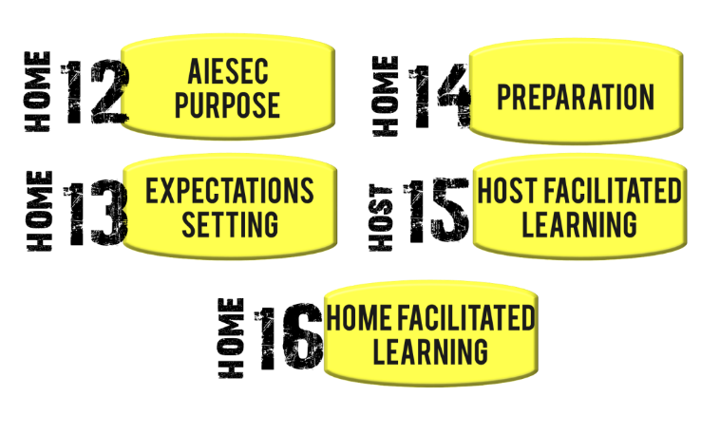

AIESEC PROJECT STANDARD

Slide 9
PROJECT STANDARD IN COTE D’IVOIRE
.
.
.
.
.
.
.
.
.
.
Only TN taker
.
.
.
.
.
.
.
.
.
.
.
.
.
.
.
.
..
Project +TN taker
.
.
.
.
.
.
.
.
.
.
.
.
.
.
.
.
..
Akwaba program
Accommodation
Clear,Concise, Precise
JD
Should be flexible
35h max/week
JD
TN taker
LEAD PROGRAM
From 25 000 fr CFA
Timeline
3 EPs min
TN taker
Cooperation with
ORganisations
Financial Substainability
Transportation Allowance
If possible
Report of EP before certificat
Project
Evaluation
Start-Middle-End

Slide 10
PROJECT PLANING

Slide 11
FOLLOW THE 5 W
WHAT
WHY
WHO
WHERE
WHEN

Slide 12
WHAT
WHY
What’s the issue project address? What is the name of project?
What are the main steps/ mile stones you have to take to prepare the project? (such as matching mania, learning circle, seminar)
What are the main areas/ activities in the project you have to focus on?
(E.g. How the international cooperation, exchange management, promotion, fund- raising will look like?)
What resources do you need to organize it? (Partnerships, Human resources, Financial resources
Why you would like to organize it, what are the reasons? Why is the project important for my surrounding?
How the results of the project will affect my surrounding?
What other people will say after the realization of event – how will they perceive it?

Slide 13
WHERE
WHEN
WHO
What are the target groups of your project?
(AIESECers, students, local society, Interns, companies, organizations, universities) How will you cooperate with those target groups?
Who will organize the project? (how many people, what kind of responsibilities) Whose help inside and outside organization will you need to prepare the project?
Where each main activity of the project will take place? Where will you work to prepare the project?
Where will you organize learning activities within the project?
Where will you promote your project?(in terms of external /outside organization/
and internal promotion/ within AIESEC network/) Where will you find all resources which you need?
What is the starting and the ending date of your project? How long the project will last?
How many time (in weeks) do you have to organize it? Till when will you deal with mile stones of the project?
What are the most important deadlines for project realization? When do you expect RESULTS of your project?
When will you focus mainly on each area of the project?

Slide 14
PLANING TOOLS
Areas | Activities | Measurements | Start | End | Responsible | Status

Slide 15
SEE EXTRA IN EXCEL DOCUMENT

Slide 16
THANK YOU

